Slide 1
for every integer n, n² ≥ n.

Slide 2
Proofs of Non-Conditional Statements

Slide 3
Methods of Proof
Direct, contrapositive and contradiction.
Some theorems have form “P if and only if Q”
Equivalent to “If P then Q and if Q then P”

Slide 4
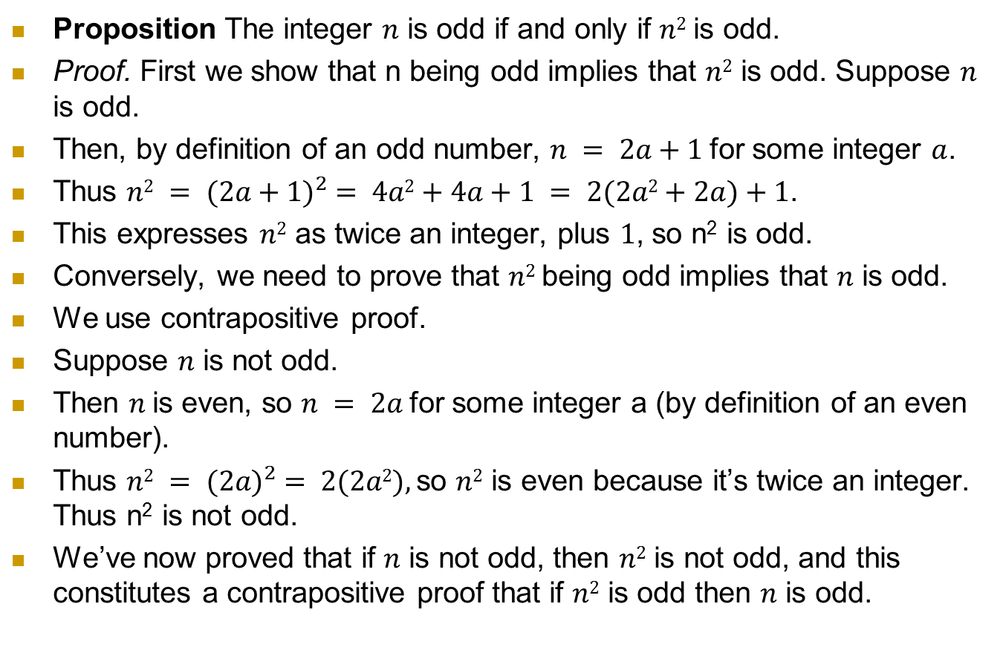
Iff Proof
Proposition The integer $n$ is odd if and only if $n2$is odd.
Proof. First we show that n being odd implies that $n2$ is odd. Suppose $n$ is odd.
Then, by definition of an odd number, $n = 2a+1$for some integer $a$.
Thus $n2 = {(2a+1)}^{2} = 4a2+4a+1 = 2(2a2+2a)+1$.
This expresses $n2$ as twice an integer, plus $1$, so n² is odd.
Conversely, we need to prove that $n2$ being odd implies that $n$ is odd.
We use contrapositive proof.
Suppose $n$ is not odd.
Then $n$is even, so $n = 2a$for some integer a (by definition of an even number).
Thus $n2 = {(2a)}^{2} = 2(2a2),$so $n2$ is even because it’s twice an integer. Thus n² is not odd.
We’ve now proved that if $n$ is not odd, then $n2$ is not odd, and this constitutes a contrapositive proof that if $n2$ is odd then $n$ is odd.

Slide 5
Iff Proof
An if-and-only-if theorem of form P ⇔Q asserts that P and Q are either both true or both false, that is, that P and Q are equivalent.
To prove P ⇔Q we prove P ⇒Q followed by Q⇒P, essentially making a “cycle” of implications from P to Q

Slide 6
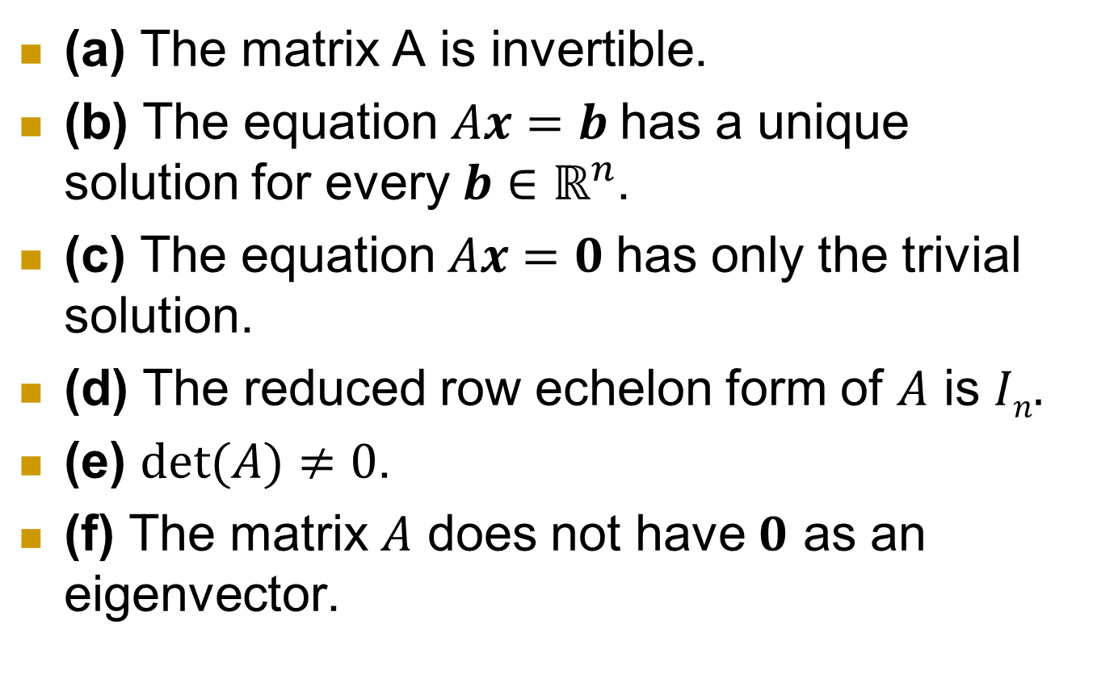
Equivalent Statements
(a) The matrix A is invertible.
(b) The equation $Ax=b$has a unique solution for every $b∈ℝ^{n}$.
(c) The equation $Ax=0$has only the trivial solution.
(d) The reduced row echelon form of $A$ is $In.$
(e) $det⁡(A)≠0$.
(f) The matrix $A$ does not have $0$ as an eigenvector.

Slide 7

Proving Statements Equivalent
Similarly, one approach to proving the theorem about the $n×n$ matrix would be to prove the conditional statement (a)⇒(b), then (b)⇒(c), then (c)⇒(d), then (d)⇒(e), then (e)⇒(f) and finally (f)⇒(a)

Slide 8
Existence Proofs
Proposition There exists an even prime number.
Proof. Observe that 2 is an even prime number. ■
Admittedly, this last proposition was a bit of an oversimplification.
Proposition There exists an integer that can be expressed as the sum of two perfect cubes in two different ways.
Proof. Consider the number 1729. Note that 1³ +12³ = 1729 and 9³ +10³ = 1729. Thus the number 1729 can be expressed as the sum of two perfect cubes in two different ways. ■

Slide 9
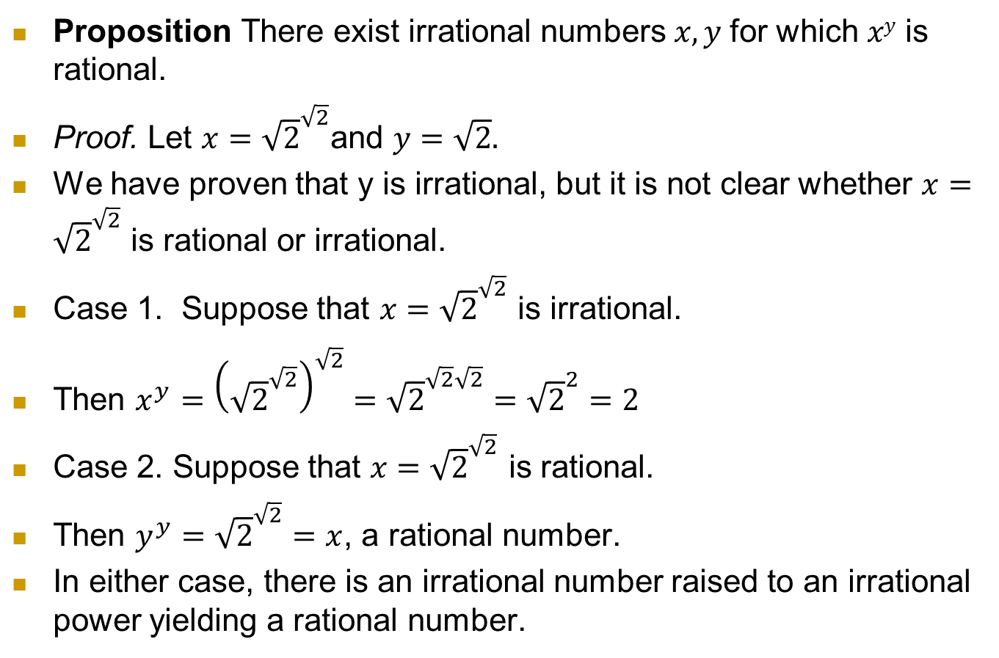
constructive Existence Proof
Proposition There exist irrational numbers $x, y$for which $xy$ is rational.
Proof. Let $x={\sqrt{2}}^{\sqrt{2}}$and $y=\sqrt{2}.$
We have proven that y is irrational, but it is not clear whether $x={\sqrt{2}}^{\sqrt{2}}$ is rational or irrational.
Case 1. Suppose that $x={\sqrt{2}}^{\sqrt{2}}$ is irrational.
Then $x^{y}={\left({\sqrt{2}}^{\sqrt{2}}\right)}^{\sqrt{2}}={\sqrt{2}}^{\sqrt{2}\sqrt{2}}={\sqrt{2}}^{2}=2$
Case 2. Suppose that $x={\sqrt{2}}^{\sqrt{2}}$ is rational.
Then $y^{y}={\sqrt{2}}^{\sqrt{2}}=x$, a rational number.
In either case, there is an irrational number raised to an irrational power yielding a rational number.

Slide 10
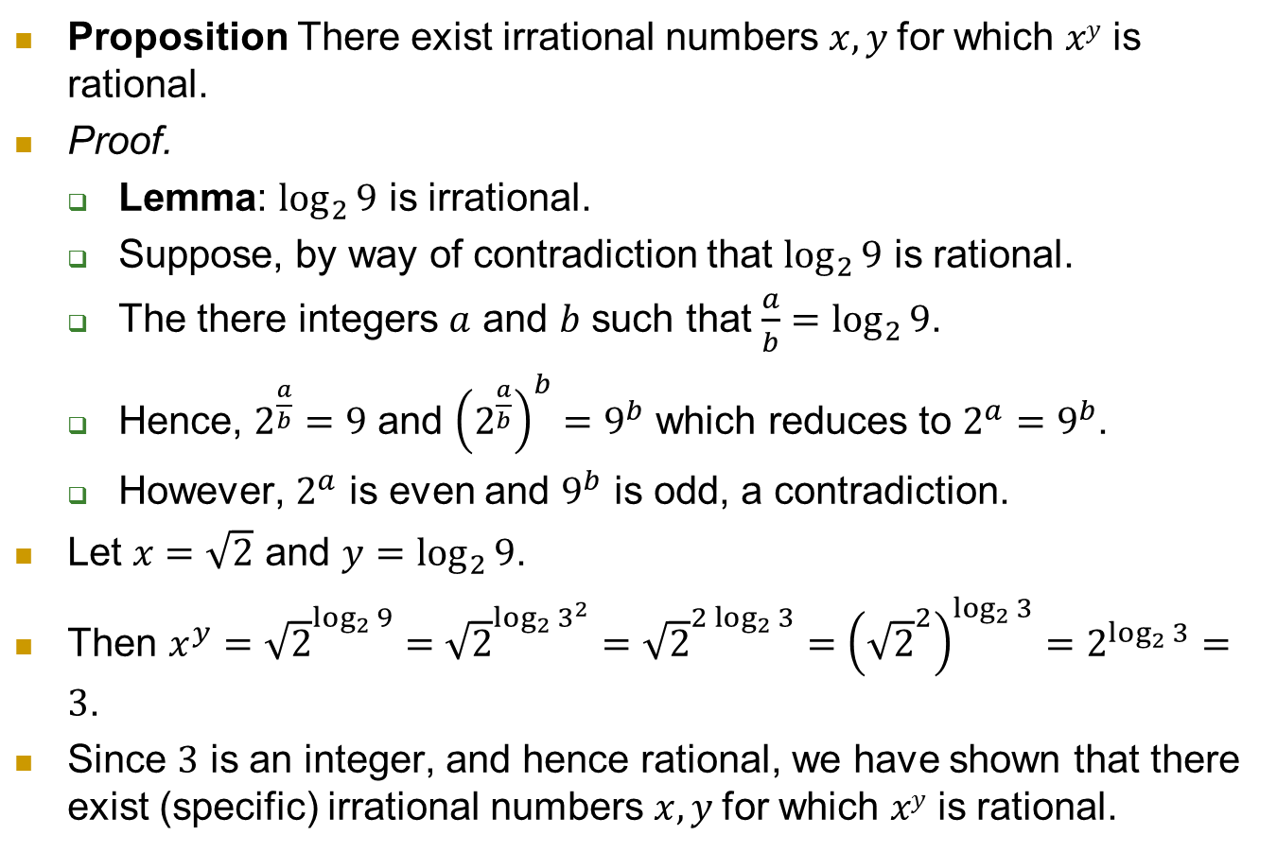
Constructive Existence Proof
Proposition There exist irrational numbers $x, y$for which $xy$ is rational.
Proof.
Lemma: $\log_{2}{9}$ is irrational.
Suppose, by way of contradiction that $\log_{2}{9}$ is rational.
The there integers $a$ and $b$ such that $\frac{a}{b}=\log_{2}{9}$.
Hence, $2^{\frac{a}{b}}=9$ and ${\left(2^{\frac{a}{b}}\right)}^{b}=9^{b}$ which reduces to $2^{a}=9^{b}$.
However, $2^{a}$ is even and $9^{b}$ is odd, a contradiction.
Let $x=\sqrt{2}$ and $y=\log_{2}{9}$.
Then $x^{y}={\sqrt{2}}^{\log_{2}{9}}={\sqrt{2}}^{\log_{2}{3^{2}}}={\sqrt{2}}^{{2 log}_{2}{3}}={\left({\sqrt{2}}^{2}\right)}^{\log_{2}{3}}=2^{\log_{2}{3}}=3$.
Since $3$ is an integer, and hence rational, we have shown that there exist (specific) irrational numbers $x, y$for which $xy$ is rational.

